Slide 1
Sports Day Event Registration System

Slide 2
Introduction
In today's fast-paced world, organizing events efficiently and allowing users to participate seamlessly is crucial. Sports Day events are no exception, often involving numerous activities and participants. To streamline the event registration process, we propose the development of a comprehensive system comprising a ReactJS web application and a backend service.
Problem Statement:
The problem at hand revolves around creating a user-friendly platform where users can register for various Sports Day events hassle-free. Key challenges include providing a clear overview of available events, preventing conflicts in event timings, and ensuring smooth registration and deregistration processes.

Slide 3
Objective
User Registration: Develop an API to allow users to register for the platform, providing essential details for identification.
User Authentication: Implement a login mechanism where users can authenticate themselves using their unique user IDs.
Event Listing: Create an API to fetch and display a comprehensive list of all Sports Day events, including details such as name, category, and timings.
Event Registration: Enable users to register for events of their choice through the platform, ensuring they cannot register for the same event multiple times.
Event Deregistration: Provide functionality for users to deregister from events they've previously signed up for.
Conflict Resolution: Implement checks to prevent users from registering for events with conflicting timings, ensuring they can only participate in one event at a time and total 3 events in a day.

Slide 4
Backend Service Overview
Create User – POST (“/api/users”)
Login User - POST (“/api/users/login”)
Get All Events List - GET (“/api/events”)
Get All Registered Events List - GET (“/api/events/registered”)
Register Event - POST (“/api/events/register”)
Unregister Event - POST (“/api/events/unregister”)

Slide 5
Frontend Overview
Viewing all events in a card tile format
Displaying event details such as name, category, and timings
Selecting and deselecting events
Displaying selected events separately
Handling constraints such as maximum event selection and timing conflicts

Slide 6
System Architecture

Slide 7
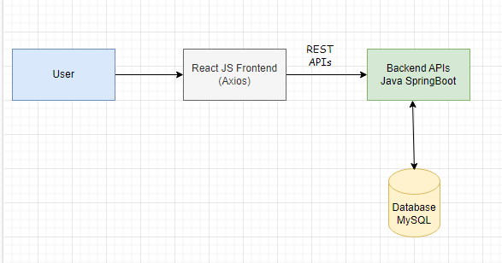

Slide 8
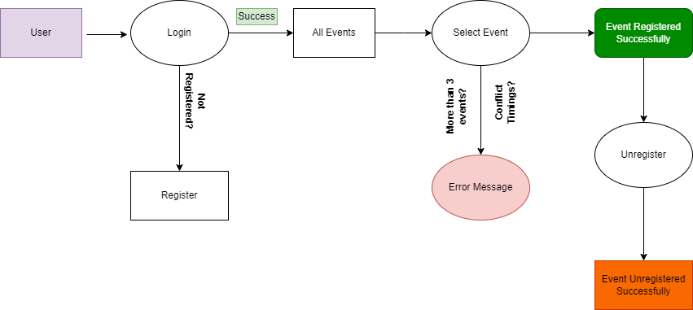

Slide 9
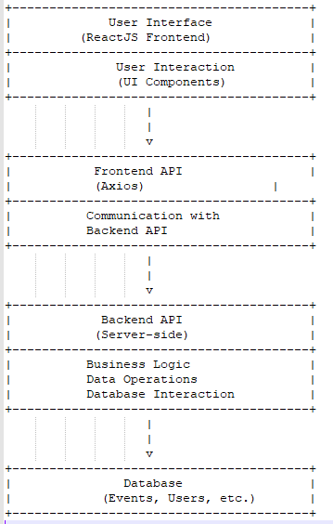

Slide 10
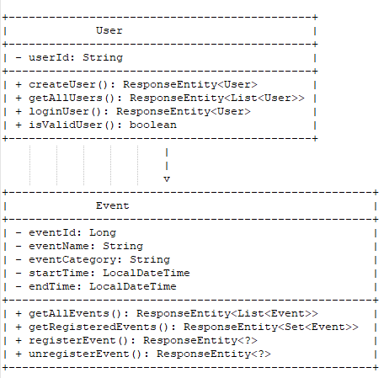
Class Diagram

Slide 11
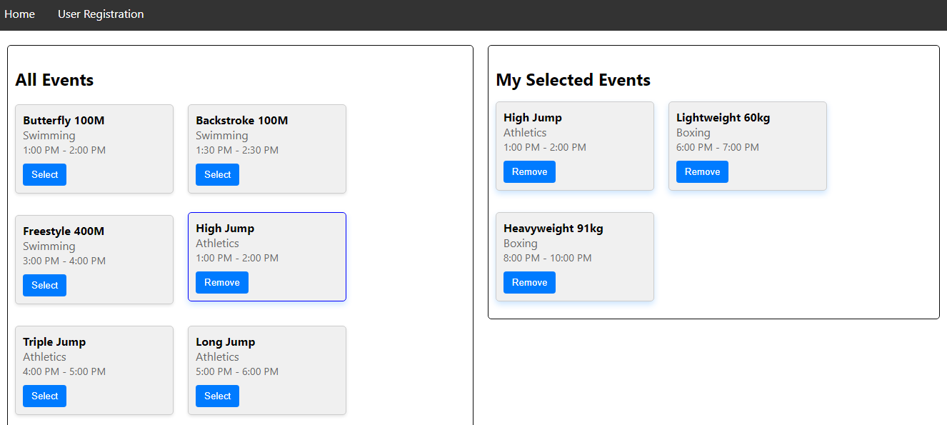
User Interface

Slide 12


